Slide 1

PROJECT CARD & DATA OVERVIEW
EASY
ADVANCED

Slide 2

PROJECT CARD
GOAL:
Build, train, test and deploy a machine learning model to predict bike rental usage based on inputs such as temperature, humidity, wind speed..etc.
We will train a model and optimize its hyperparameters using SK-Learn.
TOOL:
AWS SageMaker Studio and Sklearn
PRACTICAL REAL-WORLD APPLICATION:
This project can be effectively used by bike rental shops to predict demand and expected future sales and understand key factors that contribute to generating revenue.
DATA:
INPUTS:
Instant, date, season, year, hour, month, holiday, weather situation, temperature, and windspeed.
OUTPUT:
casual: count of casual users
registered: count of registered users
cnt: count of total rental bikes including both casual and registered
Image Source: https://pixabay.com/photos/bike-rental-bikes-rent-pay-2284380/
Dataset Source: Hadi Fanaee-T, Laboratory of Artificial Intelligence and Decision Support (LIAAD), University of Porto INESC Porto, Campus da FEUP Rua Dr. Roberto Frias, 378 4200 - 465 Porto, Portugal
Image Source: https://www.flickr.com/photos/pasa/6757993805
Dataset Source: https://www.kaggle.com/ljanjughazyan/cars1

Slide 3
DATA EXPLORATION: INPUTS
Inputs:
instant: record index
dteday: date
season: season (1: springer, 2: summer, 3: fall, 4: winter)
yr: year (0: 2011, 1: 2012)
mnth: month ( 1 to 12)
hr: hour (0 to 23)
holiday: whether day is holiday or not - weekday : day of the week
Working day: if day is neither weekend nor holiday is 1, otherwise is 0.
weathersit :
1: Clear, Few clouds, Partly cloudy
2: Mist + Cloudy, Mist + Broken clouds, Mist + Few clouds, Mist
3: Light Snow, Light Rain + Thunderstorm + Scattered clouds, Light Rain + Scattered clouds
4: Heavy Rain + Ice Pallets + Thunderstorm + Mist, Snow + Fog
temp : Normalized temperature in Celsius. The values are divided to 41 (max)
windspeed: Normalized wind speed. The values are divided to 67 (max)

Slide 4
DATA EXPLORATION: OUTPUTS
Outputs:
casual: count of casual users
registered: count of registered users
cnt: count of total rental bikes including both casual and registered

Slide 5
MODEL OVERVIEW
TEMPERATURE
WEATHER
MACHINE LEARNING REGRESSION MODEL
WINDSPEED
SEASON
BIKE USAGE COUNT (TOTAL)
MONTH

Slide 6
HYPERPARAMETERS 101
EASY
ADVANCED

Slide 7
HYPERPARAMETERS VS. PARAMETER
Hyperparameter optimization is a key step in developing any machine learning project.
After training multiple models, you would like to fine tune them so that they perform better on a given dataset.
HYPERPARAMETER
PARAMETER
Parameter: values that are obtained by the training process such as network weights and biases.
Hyper parameter: values set prior to the training process such as number of neurons, layers, learning rate..etc

Slide 8
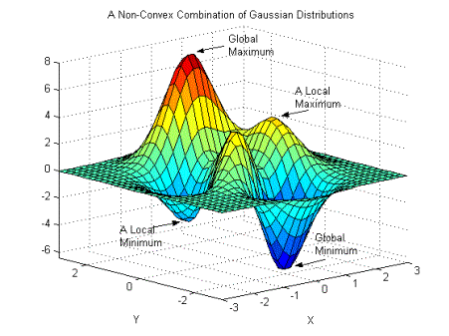
LEARNING RATE
An important parameter used during training is known as the “learning rate”.
Learning rate is a hyperparameter that represents the size of the steps taken which indicates how aggressive you’d like to update the parameters.
If learning rate increases, the area covered in the search space will increase so we might reach global minimum faster.
However, we can overshoot the target.
For small learning rates, training will take much longer to reach optimized weight values
Photo Credit: https://commons.wikimedia.org/wiki/File:Non-Convex_Objective_Function.gif

Slide 9
BATCH SIZE
Batch size indicates the number of samples that will propagate through the algorithm.
Example: Let’s assume that we have 1000 images for training. For batch size = 50, the first 50 images (from index 1 to index 50) will be propagated to the training algorithm and used for training. Then the next 50 images are propagated (index 51 to index 100). Procedure is repeated until we use all the training data.
You can use large or small batch size, in the previous example, you can use batch size = 50 or 1000.
Note that we can shuffle the training dataset between samples and this will lead to very different results every time we train the network.
If the batch size is small, ML models can easily escape local minimum areas!
If the batch size is large, ML models can get stuck in a local minimum.

Slide 10
HYPERPARAMETERS TUNING STRATEGIES
EASY
ADVANCED

Slide 11
HYPERPARAMETERS OPTIMIZATION STRATEGIES
Three widely adopted strategies are as follows:
Grid Search
Randomized Search
Bayesian Optimization

Slide 12
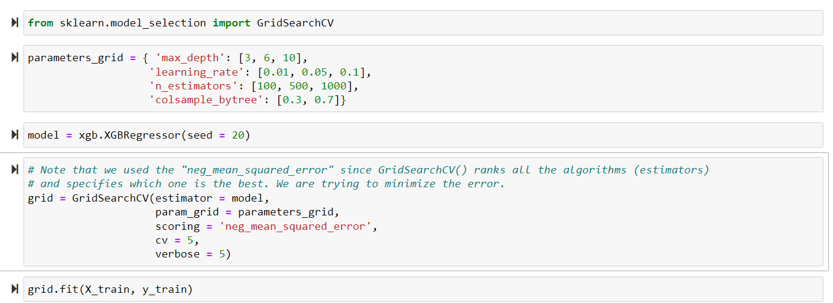
1. GRIDSEARCH
GridSearch performs exhaustive Search over a specified list of parameters.
You provide the algorithm with the hyperparameters you’d like to experiment with and the values we want to try out.
Note that you will have the following number of combinations: 3 * 3 * 3 * 2 = 54.
We will run each combination 5 times since we set the crossvalidation = 5.
Total number of runs = 54 * 5 = 270

Slide 13
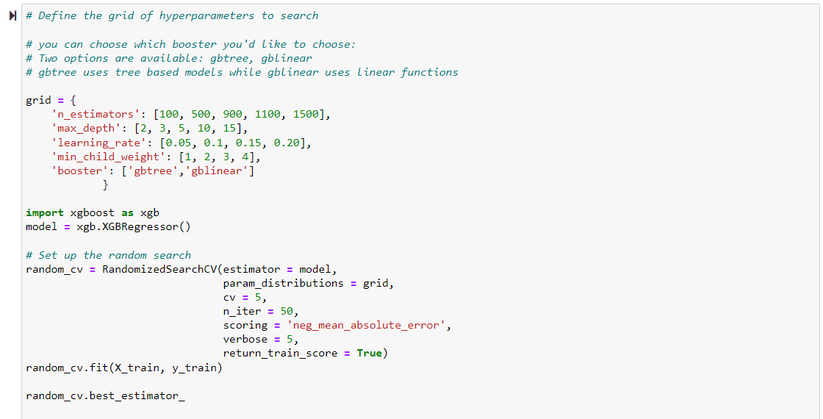
2. RANDOMIZED SEARCH
Grid search works great if the number of combinations are limited.
In scenarios when the search space is large, RandomizedSearchCV is preferred.
The algorithm works by evaluating a select few numbers of random combinations.
You have the freedom and control over the number of iterations.

Slide 14
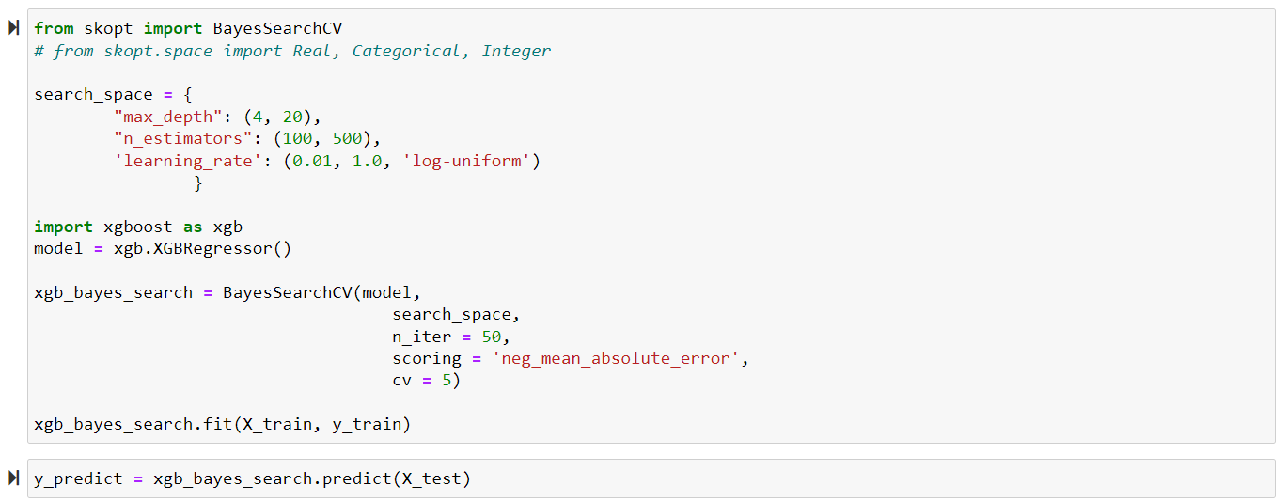
3. BAYESIAN OPTIMIZATION
Bayesian optimization overcomes the drawbacks of random search algorithms by exploring search spaces in a more efficient manner.
If a region in the search space appears to be promising (i.e.: resulted in a small error), this region should be explored more which increases the chances of achieving better performance!
You will need to specify the parameters search space.

Slide 15
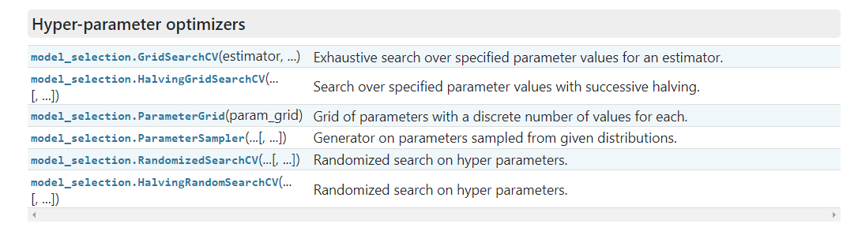
HYPERPARAMETERS OPTIMIZATION IN SKLEARN
Several optimization options are available in Scikit-Learn.

Slide 16
BIAS VARIANCE TRADEOFF
EASY
ADVANCED

Slide 17
BIAS VARIANCE INTUITION
PERFECT (TRUE) MODEL!
Let’s assume that we want to get the relationship between the Temperature and weekly sales.
As temperature increase, people tend to be happier and shop more.
This will likely increase the weekly sales.
As temperature goes beyond a certain limit, sales tend to plateau and they do not increase anymore.
WEEKLY SALES
TEMPERATURE

Slide 18
BIAS VARIANCE TRAINING VS. TESTING DATASETS
Dataset is divided to training and testing datasets
Testing datasets have never been seen by the model before
WEEKLY SALES
TESTING DATASET
TRAINING DATASET
TEMPERATURE

Slide 19
BIAS AND VARIANCE: SIMPLE MODEL
PERFECT (TRUE) MODEL!
Linear Regression model uses a straight line to fit the training dataset
Linear regression model lacks flexibility so it cannot properly fit the data (as the true perfect model does!)
The linear model has a large “bias” which indicates that the model is unable to accurately capture the true relationship between temperature and weekly sales.
WEEKLY SALES
LINEAR REGRESSION MODEL
TRAINING DATASET
TEMPERATURE

Slide 20
BIAS AND VARIANCE: COMPLEX MODEL
PERFECT (TRUE) MODEL!
High order polynomial model is able to have a very small bias and can perfectly fit the training dataset.
High-order polynomial model is very flexible
WEEKLY SALES
HIGH ORDER POLYNOMIAL MODEL
TRAINING DATASET
TEMPERATURE

Slide 21


BIAS AND VARIANCE: MODEL #1 Vs. MODEL #2 DURING TRAINING
PERFECT (TRUE) MODEL!
PERFECT (TRUE) MODEL!
WEEKLY SALES
WEEKLY SALES
LINEAR REGRESSION MODEL
HIGH ORDER POLYNOMIAL MODEL
TEMPERATURE
TEMPERATURE
SUM OF SQUARES (LARGE)
SUM OF SQUARES (SMALL ~0)
THIS IS NOT THE WHOLE STORY!!

Slide 22
BIAS AND VARIANCE: MODEL #1 Vs. MODEL #2 DURING TESTING
PERFECT (TRUE) MODEL!
PERFECT (TRUE) MODEL!
WEEKLY SALES
WEEKLY SALES
LINEAR REGRESSION MODEL
HIGH ORDER POLYNOMIAL MODEL
TEMPERATURE
TEMPERATURE
SUM OF SQUARES (SMALL)
SUM OF SQUARES (LARGE)
The polynomial model performs poorly on the testing dataset and therefore it has large variance

Slide 23
MODEL COMPLEXITY VS. ERROR
Regularization works by reducing variance at cost of adding some bias to the model.
A trade-off between variance and bias occurs.
OPTIMUM MODEL
TOTAL ERROR
VARIANCE
ERROR
BIAS
MODEL COMPLEXITY
LINEAR
POLYNOMIAL

Slide 24
MODEL COMPLEXITY VS. ERROR
MODEL #1 (LINEAR REGRESSION) (SIMPLE) | MODEL #2 (HIGH ORDER POLYNOMIAL) (COMPLEX)
Model has High bias because it is very rigid (not flexible) and cannot fit the training dataset well | Model has small bias because it is flexible and can fit the training dataset very well.
Has small variance (variability) because it can fit the training data and the testing data with similar level (the model is able to generalize better) and avoids overfitting | Has large variance (variability) because the model over fitted the training dataset and it performs poorly on the testing dataset
Performance is consistent between the training dataset and the testing dataset | Performance varies greatly between the training dataset and the testing dataset (high variability)
Good generalization | Over fitted
Variance measures the difference in fits between the training dataset and the testing dataset
If the model generalizes better, the model has small variance which means the model performance is consistent among the training and testing datasets
If the model over fits the training dataset, the model has large variance
PERFECT REGRESSION MODEL SHALL HAVE SMALL BIAS AND SMALL VARIABILITY!
A TRADEOFF BETWEEN THE BIAS AND VARIANCE SHALL BE PERFORMED FOR ULTIMATE RESULTS

Slide 25
BASICS: L2 REGULARIZATION
(RIDGE REGRESSION)
EASY
ADVANCED

Slide 26
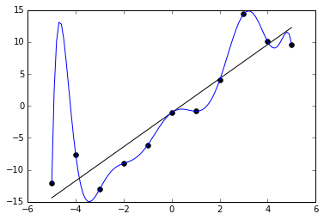
REGULARIZATION: INTUITION
Regularization techniques are used to avoid networks overfitting
Overfitting occurs when the model provide great results on the training data but performs poorly on testing dataset.
Overfitting occurs when the model learns all the patterns of the training dataset but fails to generalize.
Overfitted models generally provide high accuracy on training dataset but low accuracy on testing and validation (evaluation) datasets
Photo Credit: https://commons.wikimedia.org/wiki/File:Overfitted_Data.png

Slide 27
RIDGE REGRESSION (L2): INTUITION
OVERFITTED MODEL
Ridge regression advantage is to avoid overfitting.
Our ultimate model is the one that could generalize patterns; i.e.: works best on the training and testing dataset
Overfitting occurs when the trained model performs well on the training data and performs poorly on the testing datasets
Ridge regression works by applying a penalizing term (reducing the weights and biases) to overcome overfitting.
WEEKLY SALES
BALANCED/GENERAL MODEL
TEMPERATURE

Slide 28
RIDGE REGRESSION (L2): INTUITION
Least sum of squares is applied to obtain the best fit line
Since the line passes through the 3 training dataset points, the sum of squared residuals = 0
However, for the testing dataset, the sum of residuals is large so the line has a high variance.
Variance means that there is a difference in fit (or variability) between the training dataset and the testing dataset.
This regression model is overfitting the training dataset
WEEKLY SALES
TRAINING
DATASET
TESTING DATASET
TEMPERATURE

Slide 29
RIDGE REGRESSION (L2 REGULARIZATION): INTUITION
Ridge regression works by attempting at increasing the bias to improve variance (generalization capability)
This works by changing the slope of the line
The model performance might be little poor on the training set but it will perform consistently well on both the training and testing datasets.
RIDGE REGRESSION
TRAINING DATASET
LEAST SQUARES REGRESSION
WEEKLY SALES
TESTING DATASET
TEMPERATURE

Slide 30

RIDGE REGRESSION (L2 REGULARIZATION): MATH
Slope has been reduced with ridge regression penalty and therefore the model becomes less sensitive to changes in the independent variable (temperature)
RIDGE REGRESSION
LEAST SQUARES REGRESSION
PENALTY TERM
WEEKLY SALES
Least Squares Regression:
$$Min(sum of the squared residuals)$$
Ridge Regression:
$$Min(sum of squared residuals+ α ∗ slope^{2})$$
TEMPERATURE

Slide 31
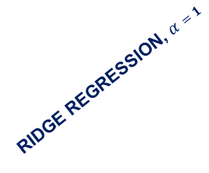
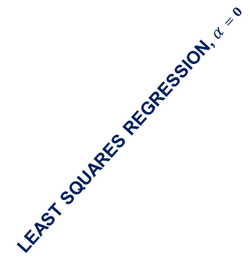

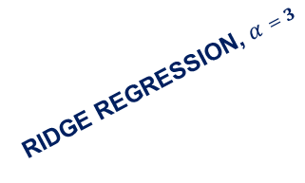
RIDGE REGRESSION (L2 REGULARIZATION): ALPHA EFFECT
As Alpha increases, the slope of the regression line is reduced and becomes more horizontal.
As Alpha increases, the model becomes less sensitive to the variations of the independent variable (Temperature)
RIDGE REGRESSION, $α=1$
LEAST SQUARES REGRESSION, $α=0$
RIDGE REGRESSION, $α=3$
WEEKLY SALES
RIDGE REGRESSION, $α=10$
TEMPERATURE

Slide 32
BASICS: L1 REGULARIZATION
(LASSO REGRESSION)
EASY
ADVANCED

Slide 33
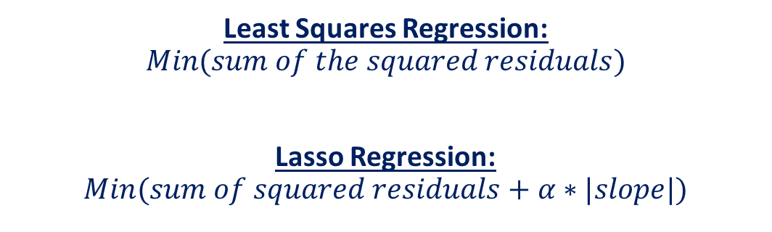
LASSO REGRESSION (L1 REGULARIZATION): MATH
Lasso Regression is similar to Ridge regression
It works by introducing a bias term but instead of squaring the slope, the absolute value of the slope is added as a penalty term
LASSO REGRESSION
LEAST SQUARES REGRESSION
PENALTY TERM
Least Squares Regression:
$$Min(sum of the squared residuals)$$
Lasso Regression:
$$Min(sum of squared residuals+α∗|slope|)$$
WEEKLY SALES
TEMPERATURE

Slide 34
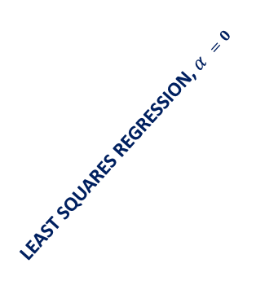

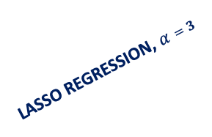
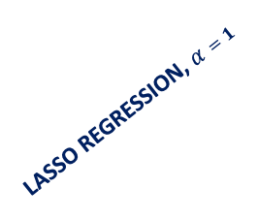
LASSO REGRESSION (L1 REGULARIZATION)
The effect of Alpha on Lasso regression is similar to its effect on ridge regression
As Alpha increases, the slope of the regression line is reduced and becomes more horizontal.
As Alpha increases, the model becomes less sensitive to the variations of the independent variable (Temperature)
LASSO REGRESSION, $α=1$
LEAST SQUARES REGRESSION, $α =0$
LASSO REGRESSION, $α=3$
LASSO REGRESSION, $α=10$
WEEKLY SALES
TEMPERATURE

Slide 35

LASSO REGRESSION: MATH
Lasso regression (L1 regularization) helps reduce overfitting and it is particularly useful for feature selection
Lasso regression (L1 regularization) can be useful if we have several independent variables that are useless
Ridge regression can reduce the slope close to zero (but not exactly zero) but Lasso regression can reduce the slope to be exactly equal to zero.
Least Squares Regression:
$$Min(sum of the squared residuals)$$
Ridge Regression (L2 regularization):
$$Min(sum of squared residuals+α∗ slope^{2})$$
Lasso Regression (L1 regularization):
$$Min(sum of squared residuals+α∗|slope|)$$

Slide 36
IN SUMMARY
L1 Regularization | L2 regularization
Used to perform feature selection so some features are allowed to go to zero | All features are maintained but weighted accordingly. No features are allowed to go to zero
When to choose L1?
If you believe that some features are not important and you can afford to lose them, then L1 regularization is a good choice.
The output might become sparse since some features might have been removed.
When to choose L2?
If you believe that all features are important and you’d like to keep them but weigh them accordingly.

Slide 37
HYPERPARAMETERS OPTIMIZATION DEMO
EASY
ADVANCED

Slide 38
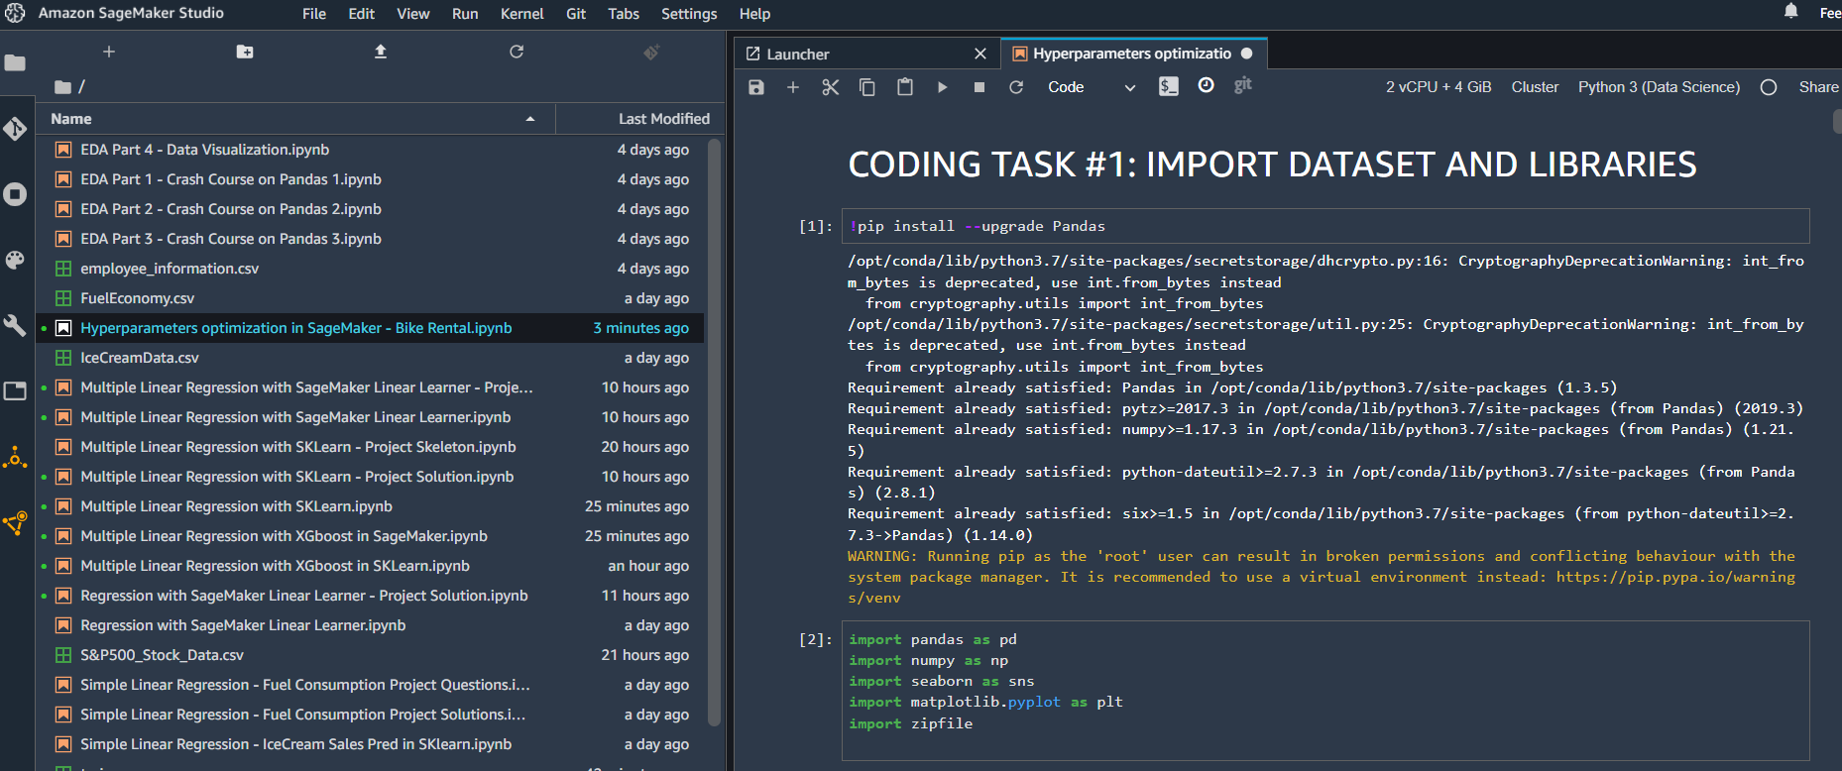
HYPERPARAMETERS OPTIMIZATION DEMO

Slide 39
FINAL END-OF-DAY CAPSTONE PROJECT
EASY
ADVANCED

Slide 40
PROJECT
Using the used car prices dataset included in the course package, perform the following:
1. Load the “used_car_price.csv” dataset
3. Split the data into 75% for training and 25% for testing
4. Train an XG-Boost model in Scikit-Learn
5. Assess trained XG-Boost model performance using RMSE and R2
6. Perform hyperparameters optimization using GridSearch, choose any reasonable values for max_depth, learning_rate, n_estimators, and colsample_bytree. Use 5 cross validation folds.
7. Perform hyperparameters optimization using RandomSearch, choose any reasonable values for max_depth, learning_rate, n_estimators, and colsample_bytree. Use 5 cross validation folds and 100 iterations.
8. Perform hyperparameters optimization using Bayesian optimization, choose any reasonable values for max_depth, learning_rate, n_estimators. Use 5 cross validation folds and 100 iterations.
9. Compare the 3 optimization strategies using RMSE and R2.

